Slide 1
Hibernate Persistence Context

Slide 2
WHAT IS PERSISTENCE CONTEXT?
A persistence context is a set of entity instances in which for any persistent entity identity there is a unique entity instance. Within the persistence context, the entity instances and their lifecycle are managed. The EntityManager API is used to create and remove persistent entity instances, to find entities by their primary key, and to query over entities.
Hibernate Native API Session (org.hibernate.Session) and JPA Entity Manager (javax.persistence.EntityManager API)
The persistence context is the first-level cache where all the entities are fetched from the database or saved to the database. It sits between our application and persistent storage.
The place where the persistent objects are created, modified and retrieved is called the Persistence Context.
The Entity Manager is the interface that lets us interact with the persistence context. Whenever we use the Entity Manager, we are actually interacting with the persistence context.

Slide 3
Entity States
new, or transient - the entity has just been instantiated and is not associated with a persistence context. It has no persistent representation in the database and no identifier value has been assigned.
Ex: CompanyDetails companyDetails=new CompanyDetails();
companyDetails.setCompanyName("Apple");
companyDetails.setCompanyChairman("Steve Jobs");
managed, or persistent - the entity has an associated identifier and is associated with a persistence context.
Ex: entityManager.persist(companyDetails);
detached - the entity has an associated identifier, but is no longer associated with a persistence context (usually because the persistence context was closed or the instance was evicted from the context)
Ex: entityManager.detach(companyDetails);
removed - the entity has an associated identifier and is associated with a persistence context, however it is scheduled for removal from the database.
Ex: entityManager.clear();

Slide 4
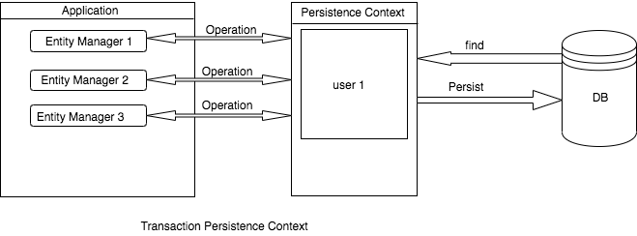
Persistence Context Type
Transaction-scoped persistence context
The transaction persistence context is bound to the transaction. As soon as the transaction finishes, the entities present in the persistence context will be flushed into persistent storage.
When we perform any operation inside the transaction, the Entity Manager checks for a persistence context. If one exists, then it will be used. Otherwise, it will create a persistence context.
The default persistence context type is PersistenceContextType.TRANSACTION. To tell the Entity Manager to use the transaction persistence context, we simply annotate it with @PersistenceContext:
@PersistenceContext
private EntityManager entityManager;

Slide 5
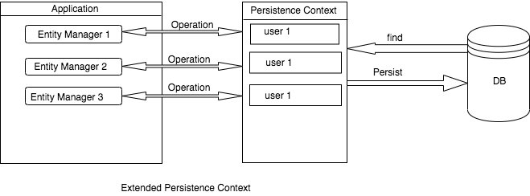
Extended-Scoped Persistence Context
An extended persistence context can span across multiple transactions. We can persist the entity without the transaction but cannot flush it without a transaction.
To tell EntityManager to use extended-scoped persistence context, we need to apply the type attribute of @PersistenceContext:
@PersistenceContext(type = PersistenceContextType.EXTENDED)
private EntityManager entityManager;

Slide 6
In Hibernate native APIs, the persistence context is defined as the org.hibernate.Session.
In JPA, the persistence context is defined by javax.persistence.EntityManager.
Example of making an entity persistent
DomesticCat fritz = new DomesticCat();
fritz.setColor(Color.GINGER);
fritz.setSex('M');
fritz.setName("Fritz");
session.save(fritz);
Reattaching detached data
Example of reattaching a detached entity
session.update( someDetachedCat );
session.saveOrUpdate( someDetachedCat );

Slide 7
Links:
https://aishwaryavaishno.wordpress.com/2013/06/07/hibernate-persistent-context-and-objects-lifecycle/
https://docs.jboss.org/hibernate/orm/4.0/devguide/en-US/html/ch03.html
https://www.baeldung.com/jpa-hibernate-persistence-context

